Slide 1
Automation of Data Flow from Volkswagen BEON to SAP DocuLink
Presented by: Blagoja Pavleski
AQA intern
Mentor: Mitko Talevski
AQA

Slide 2





Project overview
The Challenge
A repetitive manual process required transferring customer response information between VW BEON Portal and SAP DocuLink.
The Solution
A two-stage Software Automation solution developed using Microsoft Power Automate.
The Goal
Automate repetitive tasks, reduce manual data entry, and improve processing efficiency.

Slide 3








Before Automation: The Manual Workflow
Search for Material Number
VW BEON Portal
Excel Entry
PDF Upload
Manually type ~40 attributes per document into Excel.
Upload the corresponding PDF in another input mask.
Navigate portal and search customer reports.
Enter the material number in the input mask.
Download & Store PDF
Open Sap & Transaction
Enter Information
Repeat
Repeat the process for every material number.
Download PDF report and manually store data.
Log In and open the right transaction.
Enter information from Excel in multiple fields.
Process Drawbacks: Repetitive work • Manual data entry • Time consumption • Risk of human error

Slide 4
Proposed Solution
Volkswagen BEON Portal
Automation 1
Automation 2
PDF -> Excel
Excel -> SAP DocuLink
Download and Store PDF
Human Verification
Check extracted data for anomalies.

Slide 5
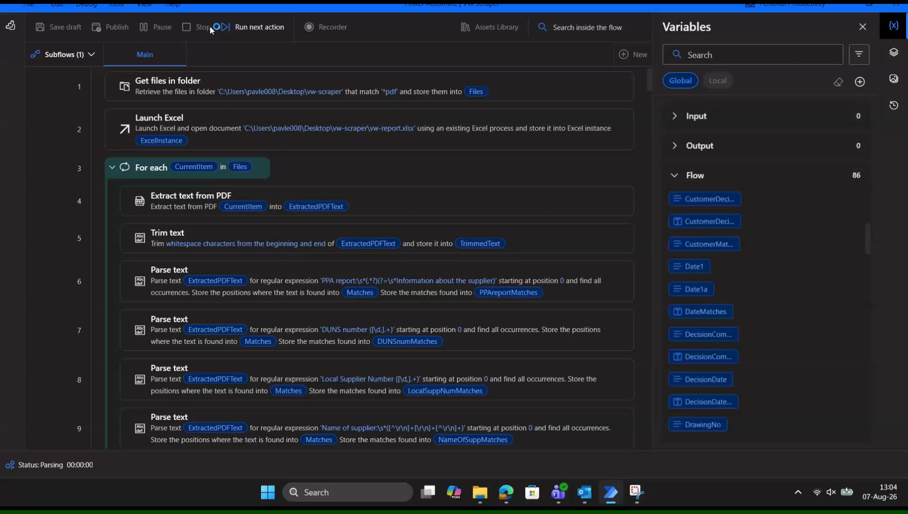
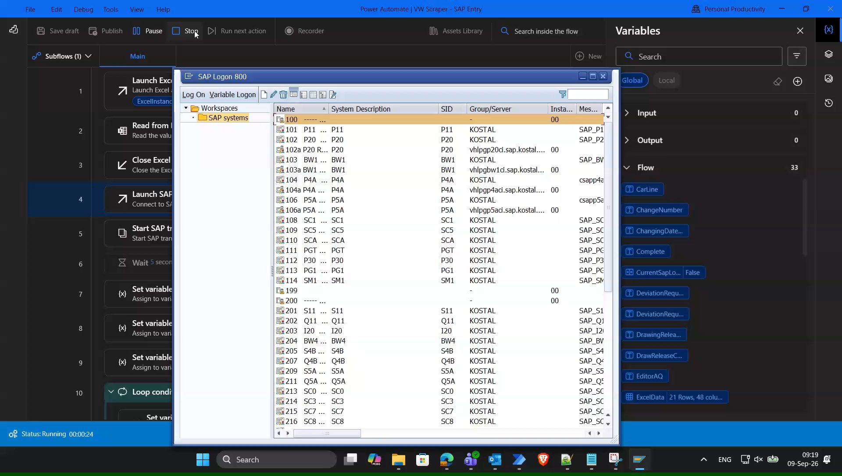
How It Works
Automation 1
Automation 2

Slide 6



Results
Processing time per document
Process | Manual | Automated
PDF -> Excel | 7:35 | 0:20
Excel -> SAP | 2:45 | 0:10
Total | 10:20 | 0:30
Performance Improvement
95.2% less processing time
20.7 x faster
Time saved per document: 9:50
Accuracy
0 mistakes

Slide 7
Financial impact – Estimated Labor Cost Saving
Average gross salary at KOSTAL: 79000 MKD / month
Working time: 160 hours / month
Hourly labor cost: 493.15 MKD / hour
Cost Per Document
Manual: 10 min. 20s -> ~ 84.90 MKD
Automated: 30s -> ~ 4.94 MKD
Saving: ~80 MKD per document
Example: 1000 Documents
Manual processing: 84,903 MKD
Automated processing: 4,938 MKD
Saving: 79,965 MKD ~ 1300€

Slide 8
Project Development and Mentorship
Mentor Contribution - Idea and Process Knowledge:
Original automation idea
Process and workflow explanation
SAP & DocuLink guidance
Daily monitoring and feedback
Testing and process validation
50+ hours of mentoring in person, with ongoing support during the whole internship.
My Contribution – Technical Design and Implementation:
Process analysis and automation design
Power Automate development
PDF data extraction and parsing
Excel data processing and validation
SAP GUI Scripting / VBScript Implementation
Testing, debugging and optimization
Result analysis and documentation.

Slide 9
Thank You
Questions?

